Slide 1


Classification challenge on Alzheimer’s Disease using MRIs and Gene Expression data
MASTER IN MEDICAL IMAGING AND APPLICATIONS
UNIVERSITY OF CASSINO
Statistical Learning and Data Mining
Carmen Guadalupe Colin Tenorio
Prof. Mario Rosario Guarracino
May 2023

Slide 2
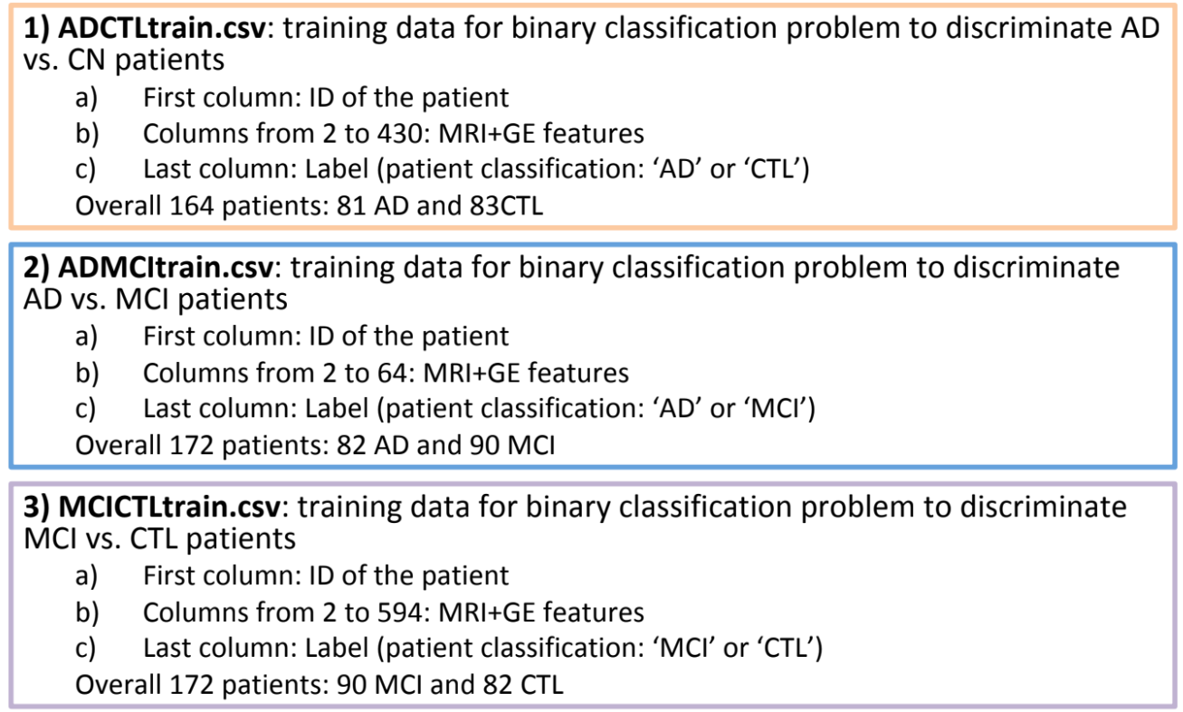
Data
Numerical values
No missing values, Outliners
Need to scale features (equal contribution)
More Features than Data:
Feature Selection strategies

Slide 3
Feature Selection and Regularization
Eliminate features with high correlation
Many features highly correlated
Hybrid Stepwise Selection: Forward and Backward
Choose best r2, Cp, bic in each case
Features with Forward + Features with Backward
Apply Regularization: Lasso Method

Slide 4
Classifiers
Explore with 5 different classifiers:
Generalized Logistic Regression
Logistic Regression
LDA
KNN
SVM
10 Cross Validation

Slide 5
ADCTL CLASSIFICATION
33
77
95
118
149
156
163
187
189
233
240
326
413
424
113
219
N° | Classifier | Acc | Acc Test | Mcc
1 | Glm | 0.9136111 | 0.82 | 0.6405126
2 | Lda | 0.9126667 | 0.84 | 0.6821865
3 | Knn | 0.8306667 | 0.84 | 0.6821865
4 | Logreg | 0.8547222 | 0.72 | 0.4400000
5 | Svm | 0.9393333 | 0.90 | 0.8006408
16 Final Features Selected.
Best Model SVM

Slide 6
MCICTL CLASSIFICATION
17
41
59
70
71
75
79
81
83
93
113
114
118
286
293
574
579
N° | Classifier | Acc | Acc Test | Mcc
1 | Glm | 0.8372222 | 0.7113095 | 0.4216788
2 | Lda | 0.8553175 | 0.7261905 | 0.4564750
3 | Knn | 0.8044444 | 0.6250000 | 0.4564750
4 | Logreg | 0.8387698 | 0.6517857 | 0.3035714
5 | Svm | 0.8537302 | 0.7500000 | 0.4988877
17 Final Features Selected.
Best Model LDA

Slide 7
ADMCI CLASSIFICATION
N° | Classifier | Acc | Acc Test | Mcc
1 | glm | 0.7028571 | 0.709375 | 0.4101870
2 | lda | 0.7202381 | 0.709375 | 0.4101870
3 | knn | 0.6780556 | 0.743750 | 0.4743416
4 | logregb | 0.7019841 | 0.612500 | 0.2195775
5 | svm | 0.7308730 | 0.743750 | 0.4743416
20
45
47
51
55
5 Final Features Selected.
Best Model SVM

Slide 8
¡Thank You!

